Slide 1
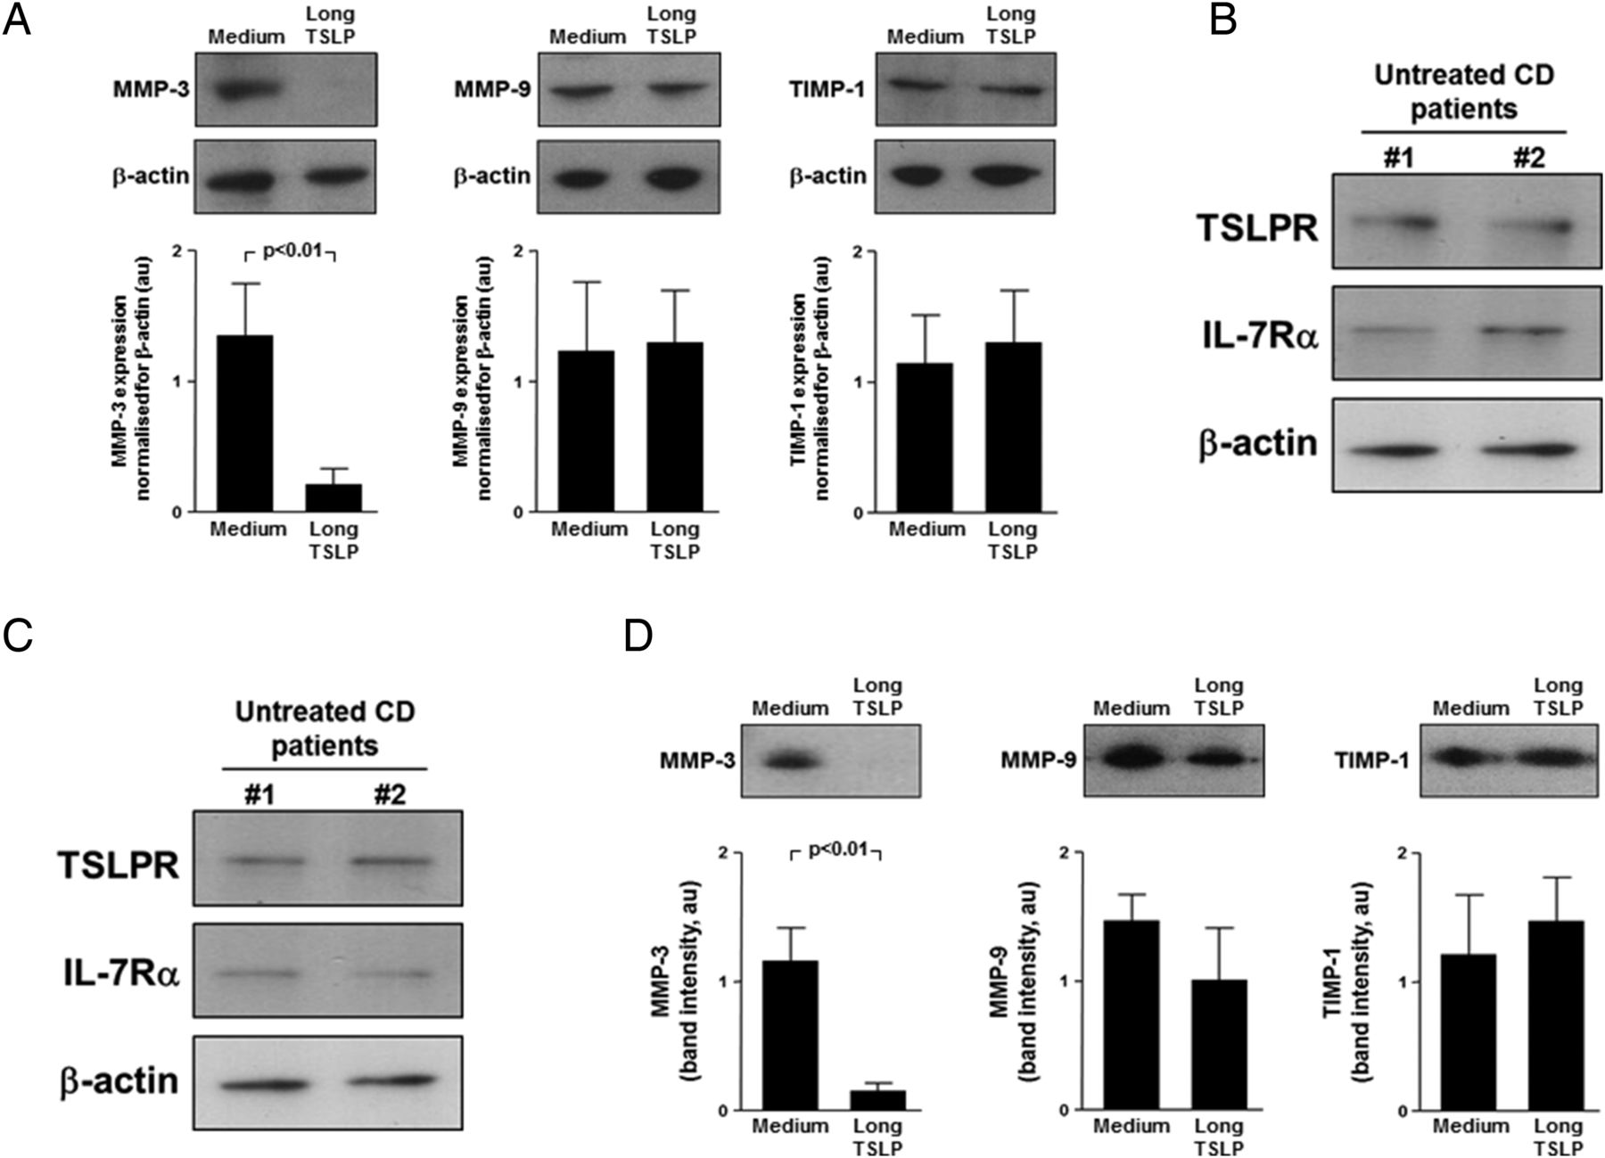

Ex vivo and in vitro effects of long thymic stromal lymphopoietin (TSLP) on matrix-metalloproteinase (MMP) production by untreated coeliac disease (CD) mucosa and myofibroblasts.
Paolo Biancheri et al. Gut 2016;65:1670-1680
Copyright © BMJ Publishing Group Ltd & British Society of Gastroenterology. All rights reserved.
Notes:
Ex vivo and in vitro effects of long thymic stromal lymphopoietin (TSLP) on matrix-metalloproteinase (MMP) production by untreated coeliac disease (CD) mucosa and myofibroblasts. (A) Recombinant human long TSLP was cultured with biopsies from six untreated patients with CD and after 24 h culture MMP-3, MMP-9 and tissue inhibitor of matrix metalloproteinase-1 (TIMP-1) production was evaluated by immunoblotting in biopsy supernatants. Examples shown in the upper panel are representative of all experiments. Blots were stripped and analysed for β-actin. Lower panel shows immunoblot densitometry. Results are mean±SEM. (B) TSLP receptor (TSLPR) and interleukin (IL)-7Rα protein, detected by immunoblotting, on lysates of mucosal myofibroblasts freshly isolated from two untreated patients with CD. Blots were stripped and analysed for β-actin. (C) TSLPR and IL-7Rα protein, detected by immunoblotting, on lysates of mucosal myofibroblasts isolated from two untreated patients with CD and cultured until passage 4. Blots were stripped and analysed for β-actin. (D) Effect of TSLP on MMP-3, MMP-9 and TIMP-1 release by untreated CD myofibroblasts. Examples shown in the upper panel are representative of six independent experiments on two different cell lines. Blots were stripped and analysed for β-actin. Lower panel shows immunoblot densitometry. Results are expressed as mean band intensity (arbitrary units)±SEM. au, arbitrary units.

